Slide 1
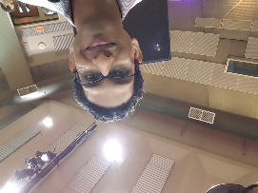
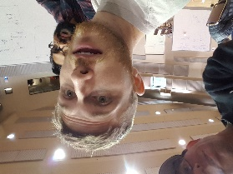


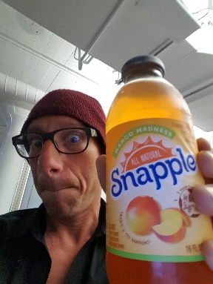
Team EarthQuake
Anurag Nanda: Programmer. Computer Science Student at SF State.
Rushab Indi: Software Guy. Interested in product development
Barclay Iversen: All Around General Bad Ass. Successful Sales Professional seeking like minded individuals for intimate coding sessions.
Sean Mandell: Data Scientist. Bay Area Native, Lives in sunset. Former Economic consultant.
Victor Lam: Project Assistant. San Francisco Native, Recent SFSU Information Systems graduate.
Gary Naham: Poughkeepsie Inhaler. Urban spelunker, Technology writer, rodeo Clown.

Slide 2
SOFT STORY SEARCH TOOL

Slide 3
Web Page based Compliance Search Engine utilizing street address
TOOLS:
Flask
jQuery
Python
PostgreSQL

Slide 4
SFBDI Website Search Tool
In 2013, the San Francisco Earthquake Safety Implementation Program was codified, affecting almost 2,000 buildings in SF.
The SFBDI offers a dot map or spreadsheet to check for your property’s qualification as a “soft story structure” and its stage of compliance with the soft story laws and regulations.
We have designed a website where a property’s status can be discovered by entering a numeric address as a search term.

Slide 5
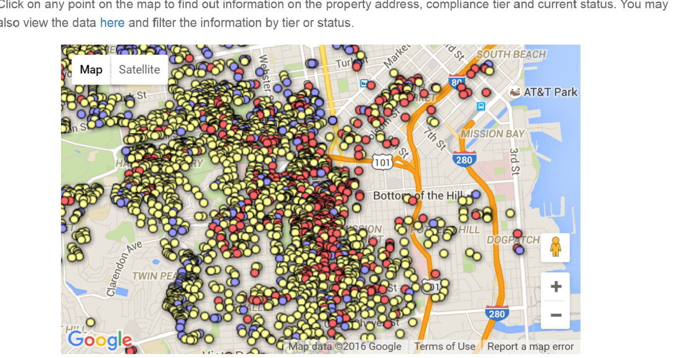
Earthquake Soft Story Search
Exisiting SFBDI Web Page allows search via Map application embedded in their page:
There is also a second option offered, an excel spreadsheet that allows you to search in multiple ways
BUT requires access to spreadsheet software AND some minimal skill using it.
This requires loading time as well, both due to bandwidth and processing constraints.

Slide 6
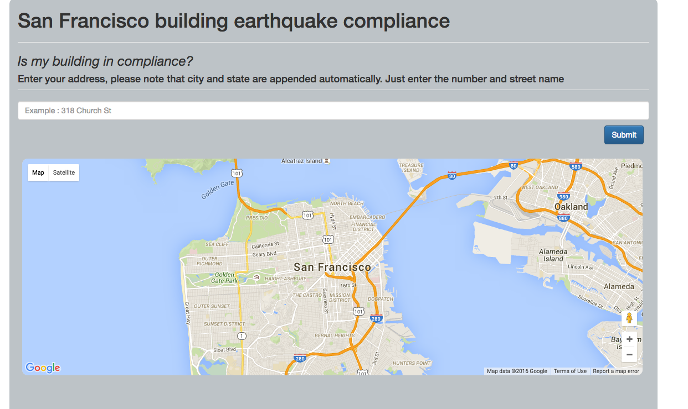

Slide 7
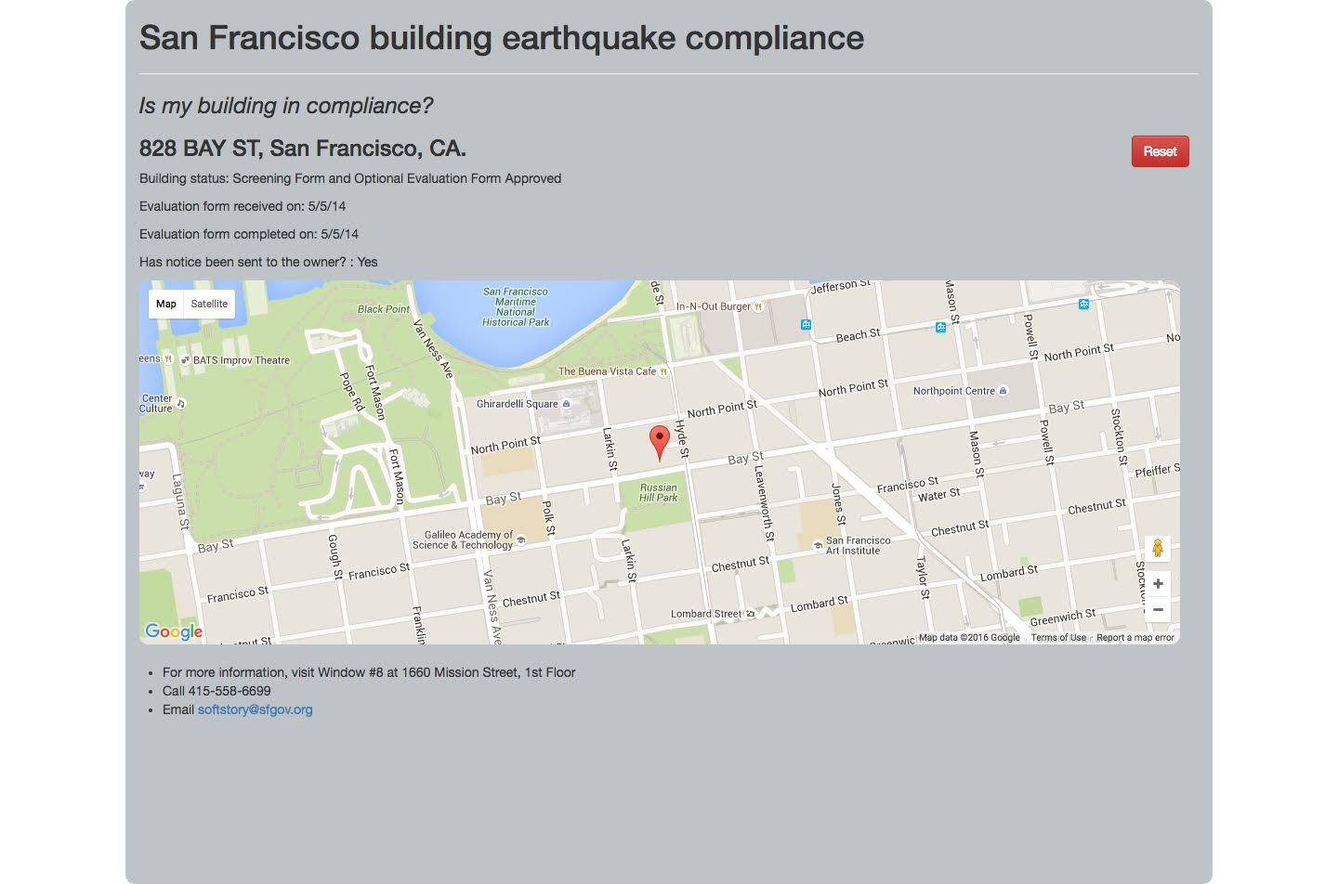

Slide 8
Linked at http://localhost:5000

Slide 9
Team EarthQuake believes our search tool
could be rapidly embedded, tested,
and
be in production on the SFBDI webpage
in as little as five business days.

